Slide 1



Language support for Cloud scale distributed programs
Christopher S. Meiklejohn
Université catholique de Louvain Instituto Superior Técnico Northeastern University

Slide 2



Distributed applications today
Application users are located all over the world.
Geo-replicate applications to increase availability and decrease user-perceived latency.

Slide 3
Geo-replicated “CP” databases
Global total order across all
geo-replicated clusters.
Total order with an elected leader node per cluster.

Slide 4
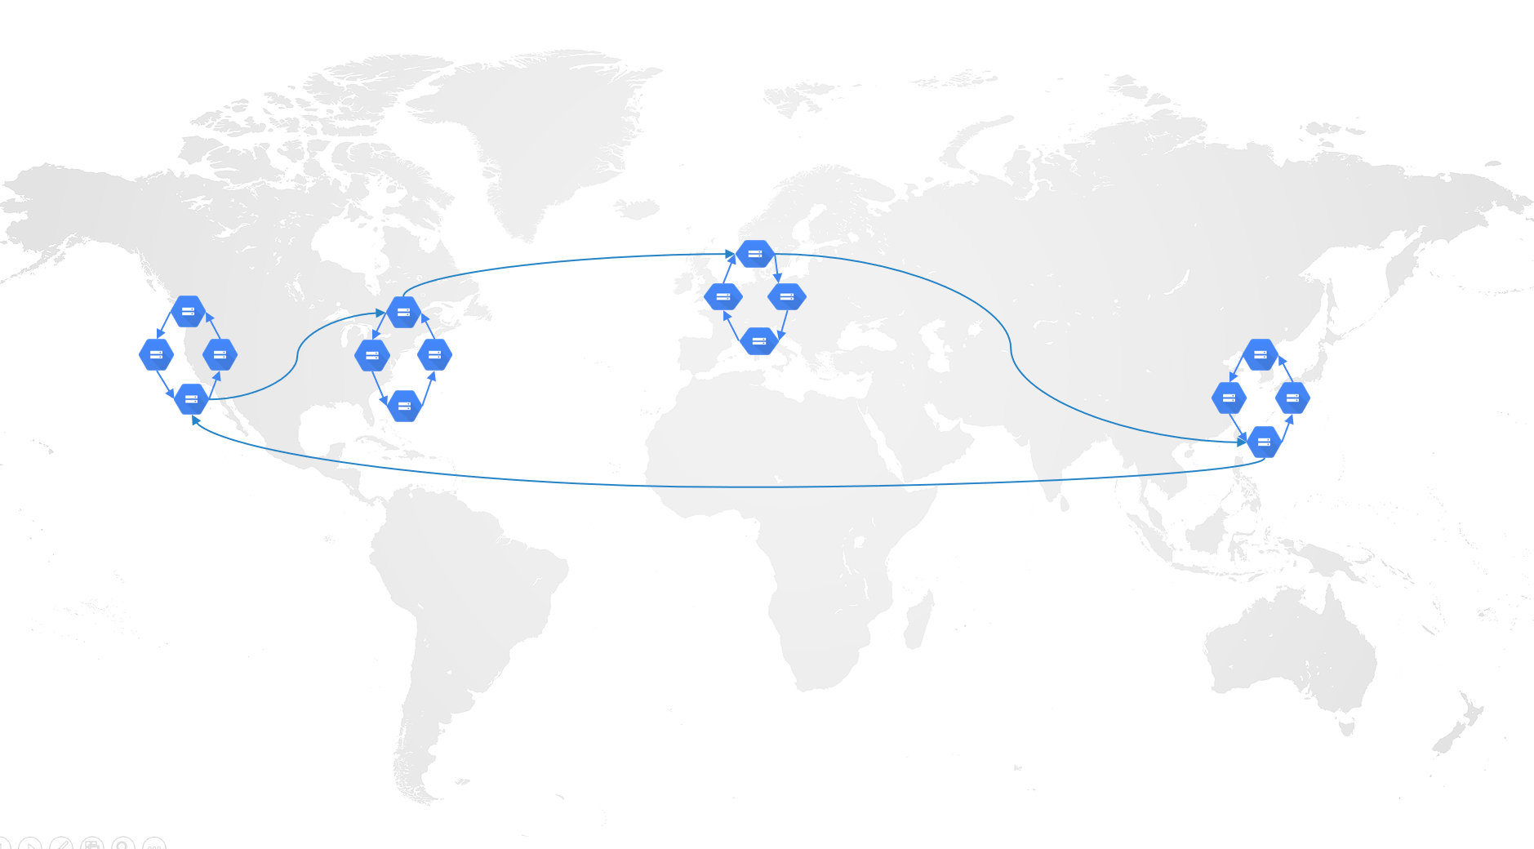
IDEAL: Global “strong consistency”
Total order allows imperative programming
Events happen globally in order
Shared “memory locations” mutated in order
Transactional guarantees
Atomicity: atomic commitment
Isolation: mutual exclusion
Key insights: slow, but easy to program
Concurrent programs with locks
Correct under arbitrary distribution
Delays under failure

Slide 5

Geo-replicated Microservices
No guaranteed event order globally because of multiple communication paths.
No guaranteed order within the data center.

Slide 6
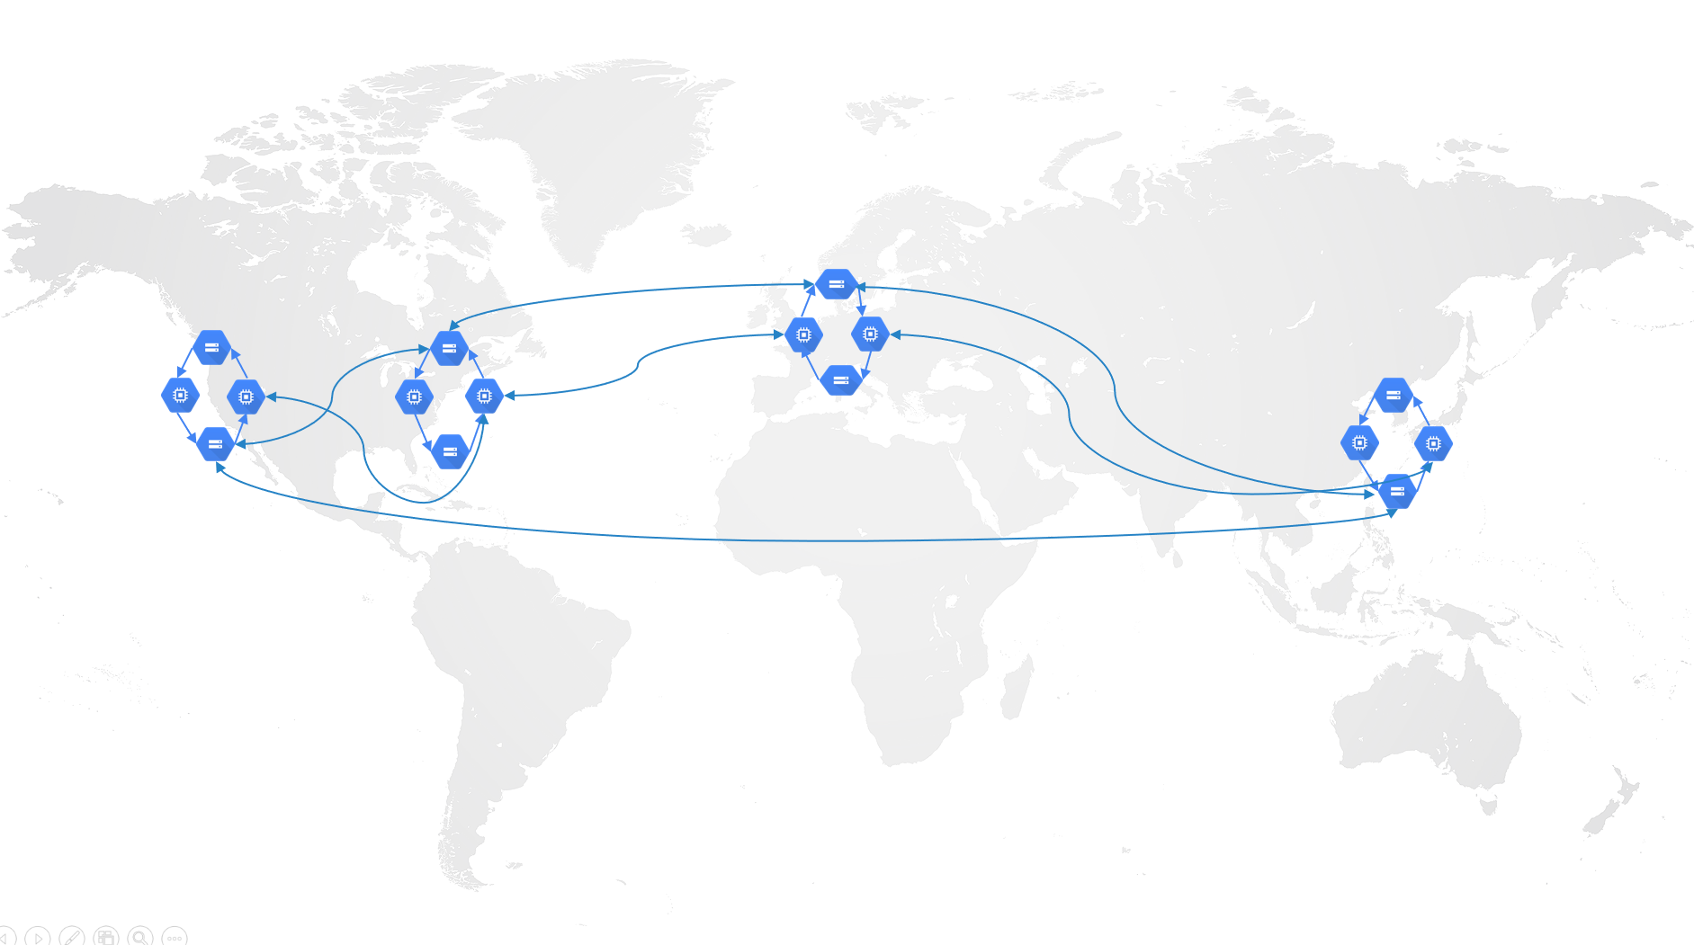
REALITY: Weakly consistent Microservices
Events happen in no well-defined order
How does one write a program where events can happen in any order?
No transactional guarantees
How does one enforce either isolation or atomicity
Key insights: fast, but difficult to program
Each service needs it’s own failure handling
Each service needs to reason about concurrency
Available under failure

Slide 7
Learning from history
Large-scale transactional distributed programming in history

Slide 8

1988 – ARGUS
RPC calls to “guardians”
Guardians are microservices
Provides sequential consistency
Invents “promises” to allow asynchrony without sacrificing order
Transactions between services using MVCC
Nested transactions used to mask RPC failure
No response, rollback and retry at another replica
Academic project funded by MIT/DOD
Built on a language called CLU
Little to no adoption in industry

Slide 9

1994 – Distributed Erlang
Asynchronous message passing
No RPC, but can be emulated
Wait when you need the response explicitly
Built-in DB constructs
Strongly-consistent database with transactions
No guarantees under failure, might hang arbitrarily
Massively successful
Ericsson AXD501
WhatsApp
Riak (NHS, FMK, League of Legends)

Slide 10

2018 – Microsoft Orleans
RPC calls
Guaranteed ordering
Explicit asynchrony when needed
Transactional actors
Transactional state transitions
Serializable transactions (2PL/2PC)
Adoption within Microsoft
Xbox Live
Halo, Gears of War 4

Slide 11
Historically…
Serializability is the gold standard
Events occur in order and are mutually excluded from one another
Difficult to provide at scale without performance impact
Apt room to exploit protocols with weaker isolation
However, how do you know when you can use weak isolation?
Is serializability needed for everything?
Can we detect precisely where serializability is required for correctness?
What is the cost of serializability?
What is “correctness” from the application point of view?

Slide 12
Application correctness
How can we exploit application performance without sacrificing invariants?

Slide 13
Totally ordering events
Total order is expensive
Under failure, notes might have to wait arbitrarily long for a response
At geo-scale is prohibitive on performance (Microsoft’s Geo, Google Spanner, CockroachDB)
Total order is unnecessary for many operations
Many operation need ordering but not a total order
Provably some operations need consensus
Weak ordering sometimes OK
If application invariants can be preserved under weak ordering, why use total ordering?
E.g. precondition invariants (check and proceed with change) need total order to be safe
Some application behavior needs consensus to be provably correct!

Slide 14
Preservation of invariants
Relative order invariants (A; B)
Ensuring an implication stays true (P ⟹ Q)
E.g. Marking an order as fulfilled, and then adding it to the list of delivered orders
Can be done without coordination, by sending the object before the referenced object
Atomic groups of changes (all-or-nothing)
Updating an object and data derived from that change
E.g. Marking an order as fulfilled and decrementing the item quantity in stock together
Can be done without coordination, by sending the updates together
Precondition invariants (if … then else, compare-and-set, etc.)
Updating an object based on a condition
E.g. Only process the order when an item is available, assuming a single item
Requires coordination: isolation of the transaction through mutual exclusion
Weaker ordering sufficient for
AP invariants.
Coordination needed for
CAP-sensitive invariants.

Slide 15
Exploiting weak consistency
What’s the path to exploiting weak ordering?

Slide 16
Research agendA
Application Code
Static analysis and program specification
Consistency Layer with Shared Storage
HATs, CRDTs, Distributed Storage
We focus here today.
Communications Layer
Reliable message passing, ordering, cluster membership
BEAM (Erlang / Elixir)
Asynchronous message passing between actors

Slide 17
Research agendA
Application Code
Static analysis and program specification
Consistency Layer with Shared Storage
HATs, CRDTs, Distributed Storage
Communications Layer
We assume distributed actors that communicate through asynchronous message passing.
Reliable message passing, ordering, cluster membership
BEAM (Erlang / Elixir)
Asynchronous message passing between actors

Slide 18
Research agendA
Application Code
Static analysis and program specification
Consistency Layer with Shared Storage
HATs, CRDTs, Distributed Storage
Communications Layer
Reliable message passing, ordering, cluster membership
BEAM (Erlang / Elixir)
Asynchronous message passing between actors

Slide 19
Communications
Partisan:
Distributed Erlang Alternative

Slide 20

Distributed erlang
Single TCP connection is a bottleneck.
All nodes communicate with all other nodes.
Nodes periodically send heartbeat messages.
Considered “failed” when X missed heartbeats.
Point-to-point messaging with a single hop.
Nodes use a single TCP connection to communicate.
Assumed that a single topology fits all applications
Distributed Erlang is not “one size fits all.”
All to all “heartbeating” is expensive and prohibitive.

Slide 21
Partisan: Scaling “Distributed” erlang
Alternative distribution layer for Erlang and Elixir applications.
Can be operated alongside Distributed Erlang
Provides point-to-point messaging and failure detection.
Best-effort message delivery
Callback behavior on detection of node failures
Pluggable “network topology” backends that can be configured at runtime.
Client/server, large-scale overlays, full mesh, etc.
Backends have various optimizations available
Optimizations
Spanning tree optimization
Causal messaging

Slide 22
Partisan: backends
Partisan:
Distributed Erlang Alternative

Slide 23
Full mesh
All nodes communicate with all other nodes.
Nodes maintain open TCP connections.
Considered “failed” when connection is dropped.
Point-to-point messaging with a single hop.
Membership is gossiped.
Similar to the default Distributed Erlang implementation – as library, not runtime

Slide 24
Client-server
Client nodes communicate with server nodes.
Server nodes communicate with one another.
Point-to-point messaging through the server.
Nodes maintain open TCP connections.
Considered “failed” when connection is dropped.
User Name
User Name
User Name
User Name

Slide 25
hyparview
Supports large-scale networks (10,000+ nodes)
Nodes maintain partial views of the network
Active views form connected graph
Passive views for backup links used to repair graph connectivity under failure
Nodes maintain open TCP connections.
Considered “failed” when connection is dropped.
Some links to passive nodes kept open for “fast” replacement of failed active nodes
Point-to-point messaging for connected nodes.
Under partial views, not all nodes might be connected directly.

Slide 26
Partisan: optimizations
Partisan:
Distributed Erlang Alternative

Slide 27

parallelism
Enable multiple TCP connections between nodes for increased parallelism.
Partition traffic using a partition key.
Automatic placement
Manual partitioning for data-heavy applications
Optimal for high-latency applications where latency can slow down sends
Messages for P₁ always routed through connection 1.
P₁
P₁
P₂
P₃
P₂

Slide 28
channels
Can be combined with parallelism for multiple channels and connections per channel.
Enable multiple TCP connections between nodes for segmenting traffic.
Alleviates head-of-line blocking between different types of traffic and destinations.
Optimal for isolating slow senders from fast senders
gossip
gossip
object
object
object

Slide 29
Monotonic channels
Enable multiple TCP connections between nodes for segmenting traffic.
Drops messages when state is increasing on the channel to reduce load and transmission of redundant information.
Think: growing monotonic hash rings, objects designated with vector clock, CRDTs, etc.
System avoids transmission of redundant rings through load shedding.
object
object
ring₃
ring₂
ring₁

Slide 30


Transitive message delivery
Lazily compute a spanning tree as messages are being sent – repair tree when necessary.
Nodes can only message nodes actively directly connected.
Messages are “forwarded” through tree links for best-effort any-to-any messaging.

Slide 31
X-bot: oracle optimized overlays
4-step optimization pass for replacement of nodes in the active view with nodes in passive view.
(for random selection of active members)
2
10
1
Not all links have equal cost – with cost determined by outside “oracle.”
Reduce dissemination latency by optimizing overlay accordingly – swap passive and active members.

Slide 32


Causal ordering
Important for overlays where message might not always take the same path!
(ie. HyParView, etc.)
Ensure messages are delivered in causal order
FIFO between process pairs of sender/receiver
Holds transitively for sending and receiving messages
A
B
Prevent C being received prior to A.
C
A

Slide 33
Reliable delivery
Buffer and retransmit messages using acknowledgements from destination
Per-message or per-channel
At-least-once delivery (to the application)
Useful for causal delivery where a dropped message might prohibit progress
Messages for P₁ are periodically retransmitted until acknowledged.
P₁M₁
P₁M₂
P₁M₁
P₂
P₃

Slide 34
Research agendA
Application Code
Static analysis and program specification
Consistency Layer with Shared Storage
HATs, CRDTs, Distributed Storage
Communications Layer
Reliable message passing, ordering, cluster membership
BEAM (Erlang / Elixir)
Asynchronous message passing between actors

Slide 35
Consistency
How to get various types of guarantees?

Slide 36
CRDT-based storage
CRDT recognizes remove at B doesn’t eliminate add issued at A, because it didn’t observe it.
How can we deal with conflicts from concurrent modification?
add(1)
{1}
add(1)
rmv(1)
{1}

Slide 37
Cure: Highly available transactions
Snapshots are
causally ordered.
inc(1)
inc(1)
1
add(1)
add(1)
{1}
dec(1)
1
rmv(1)
{1}
Transactions across data items stored on different servers.
Effects of concurrent transactions can be merged and never abort.

Slide 38
Consistency
Conflict-free Replicated Data Types (CRDTs)
Enable convergence of data with weak ordering by predefining rules for conflict resolution
Cure: Highly Available Transactions
Causally-consistent snapshots
Avoid need for aborts by merging concurrent updates
Enables atomic commitment and relative ordering of updates
What about precondition invariants?
Coordination is still required for precondition invariants
Typically requires ACID transactions – but how do we know when to use them?

Slide 39
Research agendA
Application Code
Static analysis and program specification
Consistency Layer with Shared Storage
HATs, CRDTs, Distributed Storage
Communications Layer
Reliable message passing, ordering, cluster membership
BEAM (Erlang / Elixir)
Asynchronous message passing between actors

Slide 40
Application code
Preserving invariants and the required event ordering.

Slide 41
CONCURRENT REMOVALS
We must block on precondition invariants to know whether or not it’s safe.
balance(500)
wd(500)
balance(500)
wd(500)
wd(500)
Withdraw must block to ensure invariant of a non-negative balance in account.
(mutual exclusion)

Slide 42
Identifying mutual exclusion
Examine operations that might happen concurrently in code
Specify all application invariants
If an invariant will be violated based on existing invariants under concurrency, forbid
Synthesize coordination only when necessary
Only coordinate when an invariant might be violated by an operation from the application
Annotate a program accordingly
CISE shows we can annotate a program accordingly with first-order logic
Can we find a way to integrate this intro the programming model?

Slide 43
Conclusion
Consensus is safe, but over conservative
Consensus allows us to be safe because of a total order
This limits high-availability and fault-tolerance
Weak consistency and weak isolation enable performance
Too many protocols, how do we know what protocol to use?
How do we know when it’s safe to be weak?
Language support for distribution can help us!
Provide reliable messaging when needed with ordering guarantees
Provide transactional semantics at the language level – picking the right consistency level
Enable analysis for knowing when it’s alright to be weak

Slide 44
Static
All nodes communicate with a set of predetermined nodes.
Nodes maintain open TCP connections.
Considered “failed” when connection is dropped.
Point-to-point messaging with a single hop for connected nodes.

Slide 45
open questions
Unified API across all backends and runtime: unsupported features
Monitors, links (rely on failure detector usage – assumes direct connection)
Synchronous calls (rely on monitors for failure detection)
Serialization
Process identifiers, references won’t serialize if node is not connected with Distributed Erlang
Workarounds: don’t use process identifiers, always register processes, avoid reference usage
If you need synchronous calls and monitors
Run Distributed Erlang alongside of Partisan for *just* those bits of functionality.
partisan_config:set(disterl, true)

